Slide 1
Strategies in Participant Education
Suzan Huckaby
Brian Nicholson, CRSP

Slide 2
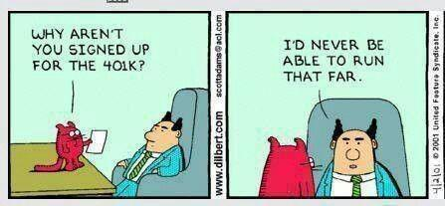
Why Educate?

Slide 3
Why Educate?
Wealth Accumulation (a focus on outcomes)
Fiduciary Responsibility/404(c)
Financial/Physical Wellness
Employer Benefits
The goal of education is to create a call to action of good behaviors….

Slide 4


How We Learn
A successful strategy incorporates how we learn
into the communication plan

Slide 5
Challenges To Effective Education
Learning Style Differences
Information Overload
Attention Spans
Complex Topics
Human Behavior
“Doesn’t Apply To Me”
Reluctance To Make Decisions/Choices
Cost Effectiveness

Slide 6
Strategies

Slide 7
Multi-Channel Delivery
A well-rounded education program has multiple delivery channels
Group Setting
Individual Meetings
Printed Materials
Web Based (i.e. Mastery Point)
Social Media
Pod Casts/ Web Casts/ Conference Call
  Small Business Servicing Strategy
Email or other Messaging

Slide 8
Audience Driven Approach
Differences in generations, gender, and other demographics force the need for different approaches to education and communication strategies
    Baby Boomers (Born 1946– 1964)
    Gen X (Born 1965 – 1980)
    Gen Y (Born 1981 – 2000)

Slide 9
Audience-Driven Approach
Differences in generations, gender, and other demographics force the need for different approaches to education and communication strategies
    Male/Female
    Salary
    Education Level
    Other Demographics

Slide 10
Targeted And Personalized
Relevant topics to the group you are trying to reach
When targeting communications –consider the demographics of the group
Keep it Simple
Tie to personal goal achievement
Put numbers and projections into context

Slide 11
Just In Time
“Tell me what is relevant for me to know now”
Education, to be most effective, should be delivered “just in time”
Education or facts that are not relevant to your audience should be omitted

Slide 12
Social Engagement Strategies
Peer Comparisons
Gamification/Incentives
Other Social Media

Slide 13
Other Thoughts
Consider holistic education to improve overall financial literacy
Implement Auto Plan Features
Simplify Investment Menus

Slide 14

Building A Successful Program
Effective education programs have an employee centric focus
Set/Create an Education Policy
Targeted and Personalized
Relevant
Must be consistent, persistent, and multi-channel
Track progress toward goals
Gather feedback from participants
Establish relationships to minimize taxable distributions at retirement

Slide 15
BPAS Tools Available
Printed Materials
Web Education – Financial Resources
Mastery Point Guidance
AdviceWare/RJ20
Retirement Gap Analysis
Income Projections
Conference Calls/Web Casts

Slide 16

Questions?

Slide 17
Contact
Suzan Huckaby
BPAS
shuckaby@bpas.com
Brian Nicholson
BPAS
bnicholson@bpas.com

