Slide 1
The Anatomy
Of A Secular Bull Market
Ralph Acampora, CMT
Altaira Ltd

Slide 2
March 2009: " A Generational Low"

Slide 3
The Early 1960 Bull Market And Today's Market Environment
Low Interest Rates
Low Inflation

Slide 4
Structural Investor Sentiment
Complacency/Greed
Belief/Trust
Disbelief/Fear
Speculative/Junk
Secondaries
Quality Bluechips
Source: “The Fourth Mega Market”, Ralph J. Acampora, CMT

Slide 5
Five Years Of Problems
2009/2011 - The Fear of A World Depression
2010/2011 - The European Crisis - "The PIIGS"
2011 - US Downgrade By S&P
2012 - "The Arab Spring"
2012/2013 - Global Slowdown
2013 - US Fiscal Cliff
2013 - Sequester
2013 - Syrian Chemical Weapons
2014 - Russia/Crimea/Ukraine

Slide 6
S&P 500 Annual Performance During The First Five Years Of This Secular Bull Market
March 2009 Low To The Year End of 2009 | +53.81%
2010 | +14.23%
2011 | + 2.20%
2012 | +14.53%
2013 | +29.67%
Source: Thomson-Reuters in US$

Slide 7
"Melt-Up" Versus "A Bubble"
Performance from December 2013 to their respective peaks in early 2014*
 | % | Peak
Dow Jones Industrial Average | +3.46 | 14 Apr 14
S&P 500 Index | +4.94 | 2 Apr 14
NASDAQ Composite | +7.57 | 5 Mar 14
PHLX Semiconductor Sector Index (SOX) | +17.98 | 3 Apr 14
S&P Mid-Cap Index | +7.02 | 2 Apr 14
Russell 2000 Index | +6.15 | 4 Mar 14
* Based on intraday highs and intraday lows, Source: Thomson-Reuters

Slide 8
Stealth Bear Market
Recent High Fliers Being Liquidated In The First & Second Quarter
 | Peak | % Decline
Facebook | 10 Mar 14 | -24.21
Amazon | 21 Jan 14 | -28.23
Twitter | 26 Dec 13 | -58.95
Yelp | 4 Mar 14 | -49.06
Tesla | 4 Mar 14 | -29.23
Netflix | 4 Mar 14 | -30.76
Zinga | 12 Mar 14 | -39.82
Source: Thomson-Reuters

Slide 9
"Rotation Is The Life-Line
Of Every Secular Bull Market"

Slide 10
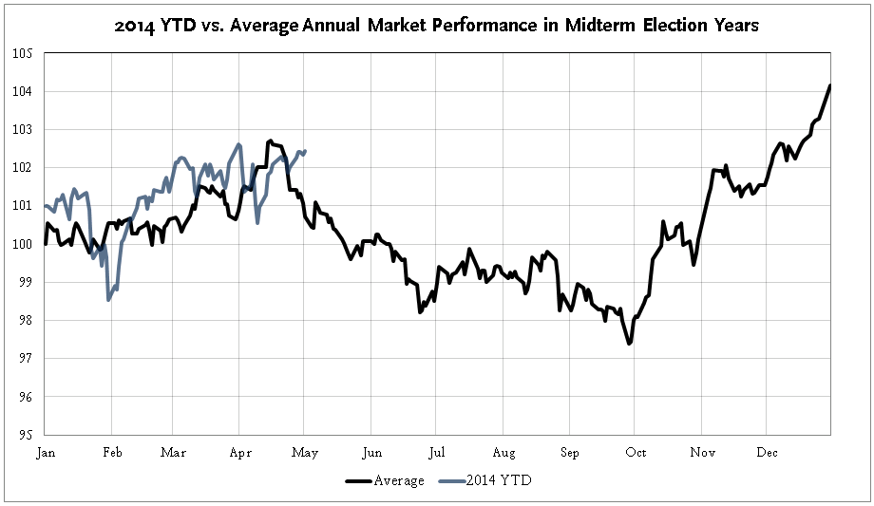
Market Performance | Midterm Election Years: The Four-Year Cycle
Weak Q2 & Q3
Positive Q1
Strong Q4
Source: Piper Jaffray Technical Research

Slide 11
Market Performance | Midterm Election Years: The Four-Year Cycle
Source: Piper Jaffray Technical Research

Slide 12
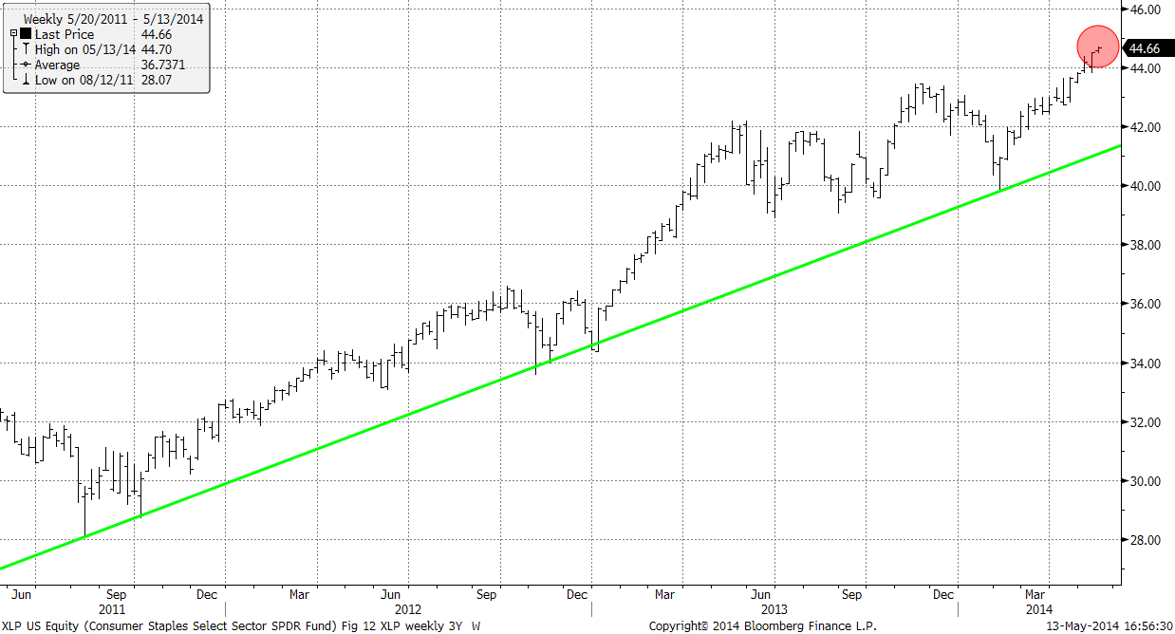
Sectors Making New Highs
Consumer Staples XLP
Source: Bloomberg

Slide 13
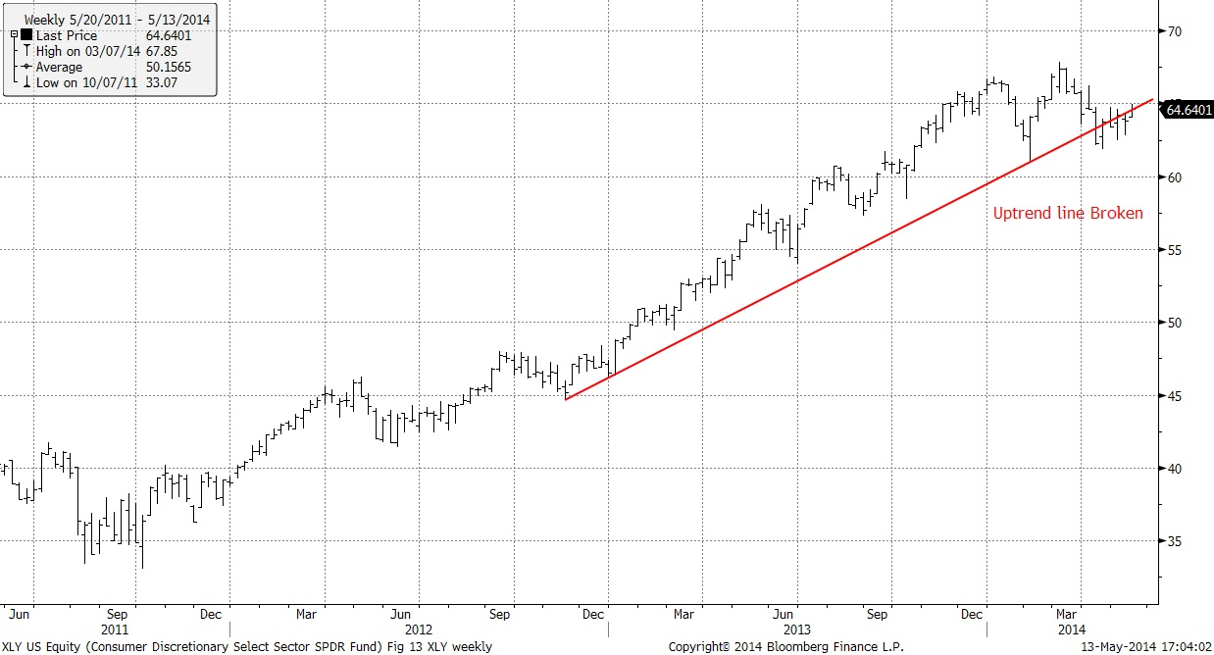
Sectors In Neutral Trends
Consumer Discretionary XLY
Source: Bloomberg

Slide 14
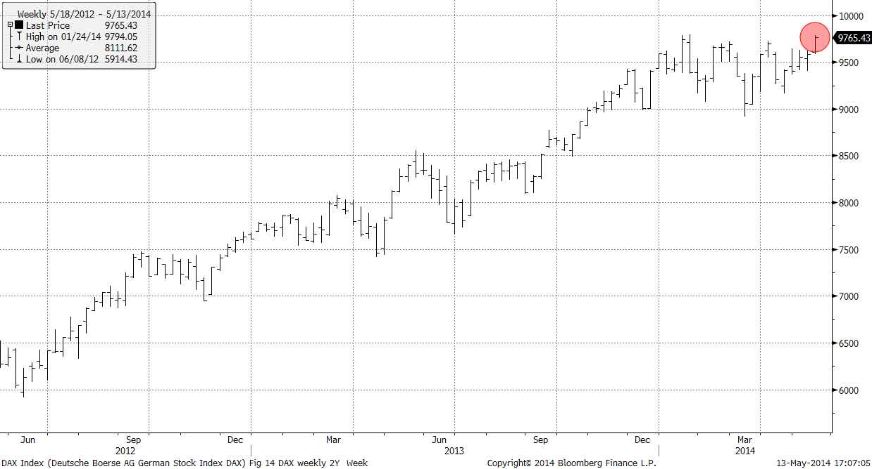
The Engine of Europe
DAX Index
Source: Bloomberg

Slide 15
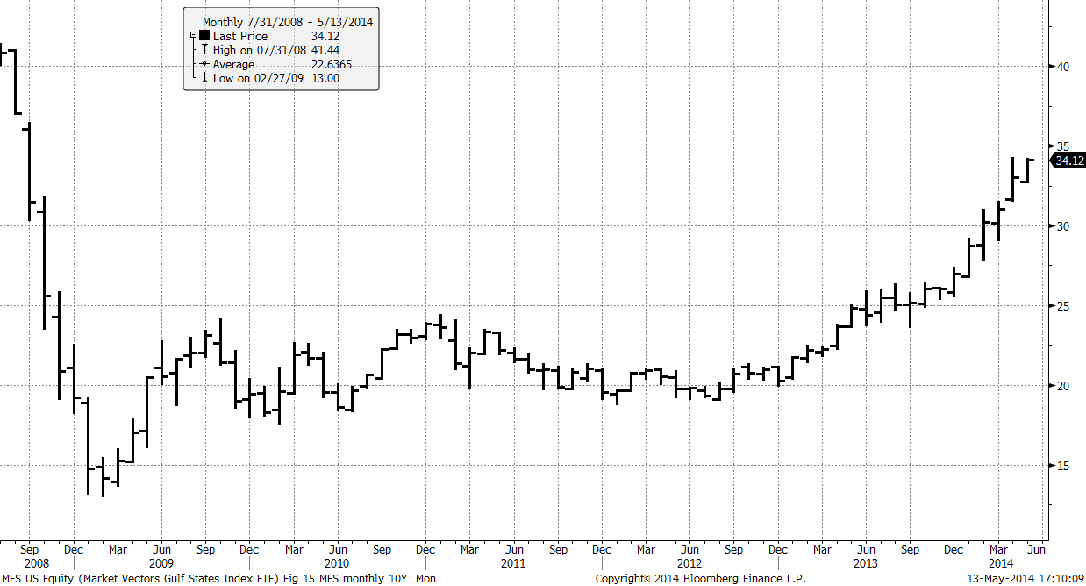
The Strong Middle East
Gulf States Index (MES)
Source: Bloomberg

Slide 16
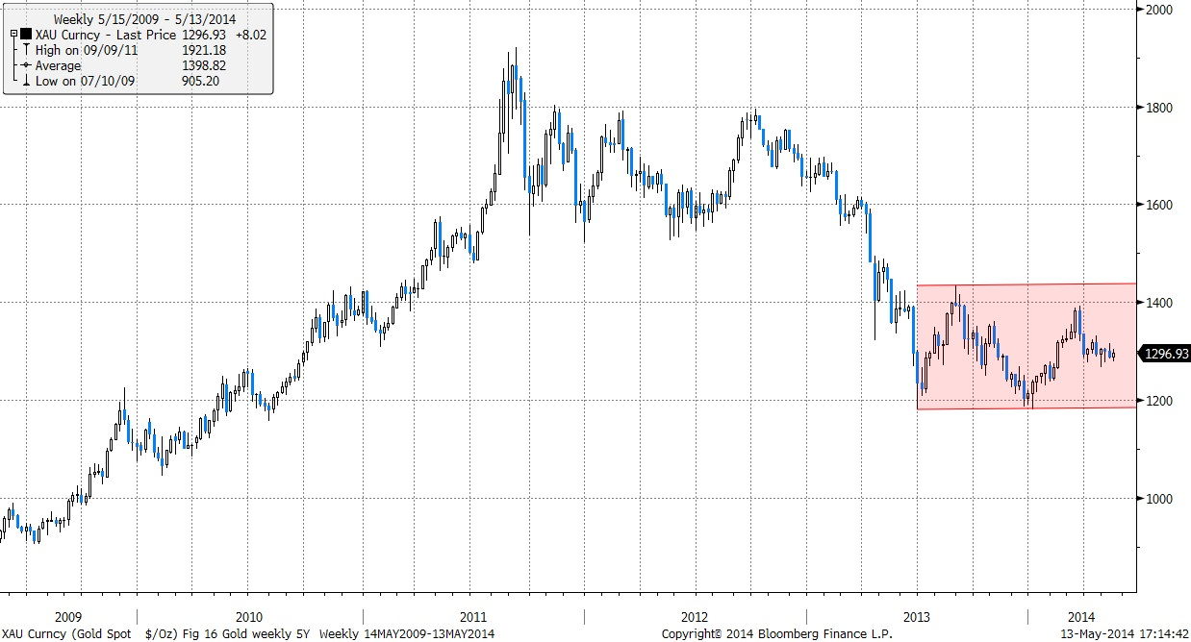
All That Glitters…
Gold (XAU)
Source: Bloomberg

Slide 17
Disclaimer
For use with Professional investors only.
This document contains general information only and is not to be acted upon without obtaining specific legal, tax and investment advice from a licensed professional. It is not an offer or solicitation to invest with Altaira Limited. Past performance is not an indication of future returns. Unless stated otherwise, the source of data is Bloomberg.

