Slide 1


DB Plans for Professional Practice and “High Cash-Flow” Clients
Vincent F. Spina, ASA, EA, MAAA
President, Harbridge Consulting Group
a BPAS Company

Slide 2

A Cautionary Tale

Slide 3

With Apologies to Derrick Coleman…
When you’re Derrick Coleman, you don’t save for retirement because you’re the #1 pick in the NBA draft in 1990
When you’re the #1 pick in the NBA draft in 1990, you end up Rookie of the Year in 1991
When you’re NBA Rookie of the Year in 1991, you sign contract extensions and earn $91M in 16 years
When you earn $91M in 16 years, you think the good times will last forever
When you think the good times will last forever, you have an enormous posse and invest in things like downtown Detroit real estate
When you have an enormous posse and invest in things like downtown Detroit real estate you eventually file chapter 7 bankruptcy
And when you file chapter 7 bankruptcy, you spend your retirement winters in Syracuse trudging through 120 inches of snow to attend Syracuse University basketball games and eat dinner with people you hardly know and don’t like because they pick up the tab
Don’t spend your retirement winters in Syracuse trudging through 120 inches of snow to attend Syracuse University basketball games and eat dinner with people you hardly know and don’t like because they pick up the tab…save more for retirement

Slide 4
Retirement Plans…
Setting the Table
Employee contributions: Pre-tax, Roth and rollover
Employer contributions made on pre-tax basis (current deduction, no Social Security, Medicare or Unemployment taxes)
Tax-deferred buildup (the “snowball effect”); many plans offer participant choice in investments
At retirement age, can roll to an IRA or withdraw gradually
Taxed as funds are withdrawn and in state of residence…hopefully when participant is in a lower Federal tax bracket and/or has moved to one of the seven states with no income tax
Held in Trust, outside reach of creditors and subject to ERISA protection (401(a), 401(k), ERISA 403(b), etc.)
When constructed properly, QRPs can be essential financial planning tools both for employees AND for business owners

Slide 5
The “qualified plan wealth transfer” concept
When employer contributions are made to a qualified retirement plan (QRP), you are essentially taking earnings that would otherwise be taxed to owners(s)/partners or paid to employees as taxable wages and transferring them directly to a QRP:
  Social Security tax avoided (EE and ER)
  Medicare Tax avoided (EE and ER)
  Unemployment Insurance Tax avoided (EE and ER)
  Federal income taxes are deferred
  State income taxes are deferred (all states except PA)

Slide 6
Retirement Income Issues
In a low interest rate environment, one will need a larger pool of assets to provide the same retirement income
To provide retirement income at age 62 of $100,000 per year to a married couple, one will need to accumulate about $1.8M…and that’s if one buys an annuity. If one wants to draw down at a rate of 5% per year and preserve principal, then one needs $2M to provide $100,000 of annual income
Some advocate a draw-down rate of 4%....meaning one would need $2.5M to produce $100,000 of annual income
How many employees/business owners are “on target” for their retirement income goals?

Slide 7
Retirement Income Issues
If an employee is receiving maximum DC plan contributions of $52,000 in 2014, and earns annual investment returns of 7%, it will take more than 17 years to accumulate $1.8M, or 19 years to accumulate $2M
If a business owner is over age 50, there is not enough time to accumulate a large enough balance in a 401(k) plan alone
How can can business owners get to their goals faster?
  Take more investment risk, or
  Increase contributions
A defined benefit plan allows a much greater amount to be contributed on a tax-deferred basis than a DC plan alone.

Slide 8
DC vs. DB Plans
Account-based plans; “Get what you get ” – based on contributions and investment performance
Promise to pay a future benefit
Annual contribution limit: $52,000 plus $5,500 catch-up if age 50+
Can be participant or trustee directed
Daily valuation is today’s standard
Need a recordkeeper….but not an actuary
No maximum benefit accrual (currently)
Not covered by PBGC
Annual contributions can be as high as $255k / participant, based on age
Trustee directed pool (participants do not have investment discretion)
Actuary performs annual valuation
Balance sheet liability (to extent of underfunding)
Max out around $2.6M per participant
May require PBGC insurance
DC Plans
DB Plans

Slide 9



Climbing the Mountain of Tax Deferral Opportunities
Cash Balance Plan ticket to admission: Between DB and DC plans, can the client afford to contribute 7.5% of pay (or more) to rank and file participants?
Up to $52,000 + $5,500,
plus DB limit ($50K - $261K)
Up to $52,000 + $5,500

Slide 10
Cross-tested
Profit-sharing Plans
General rule – you can’t “discriminate” in favor of HCEs
Generally speaking, max is a 3:1 ratio between the highest and lowest rate groups in the allocation (e.g., 3% for NHCE/max 9% for HCE)
  Minimum contribution rate of 5% for NHCEs allows for a 5:1 ratio, so 5% for NHCEs means max 25% for HCEs
  Minimum contribution of 7.5% for NHCEs means no ratio test: maximum contribution will be based on results of non-discrimination testing and IRC Section 415 limits
Age-weighted versus new comparability – one may work better than the other, based on situation and employee demographics
Can be in addition to 401(k) and match, or coordinated with 3% SH QNEC
Vesting can be used on profit sharing source (excluding any SH portion)

Slide 11
What is a Cash Balance Plan?
Defined Benefit Plan that looks to participants like a balance-forward Defined Contribution Plan
Credits…and only “DB guarantees” to the account are:
  Service Credits (e.g. 2.5% of pay or a flat amount such as $100,000), and
  Interest Credits
    A fixed amount (e.g. 3%),
    Tied to an index (e.g. 5 or 10 year Treasury yields) that change year to year, or
    The actual return on plan assets
    If the actual return on plan assets is used, then there is a minimum floor of 0% return over a participant’s career (but can have a negative return for a particular year)

Slide 12

What is a Cash Balance Plan?
Participants receive an annual statement of their “notational account balance”
Assets of a Cash Balance Plan are managed like other DB plans, as one pool….participants do not have investment direction options

Slide 13
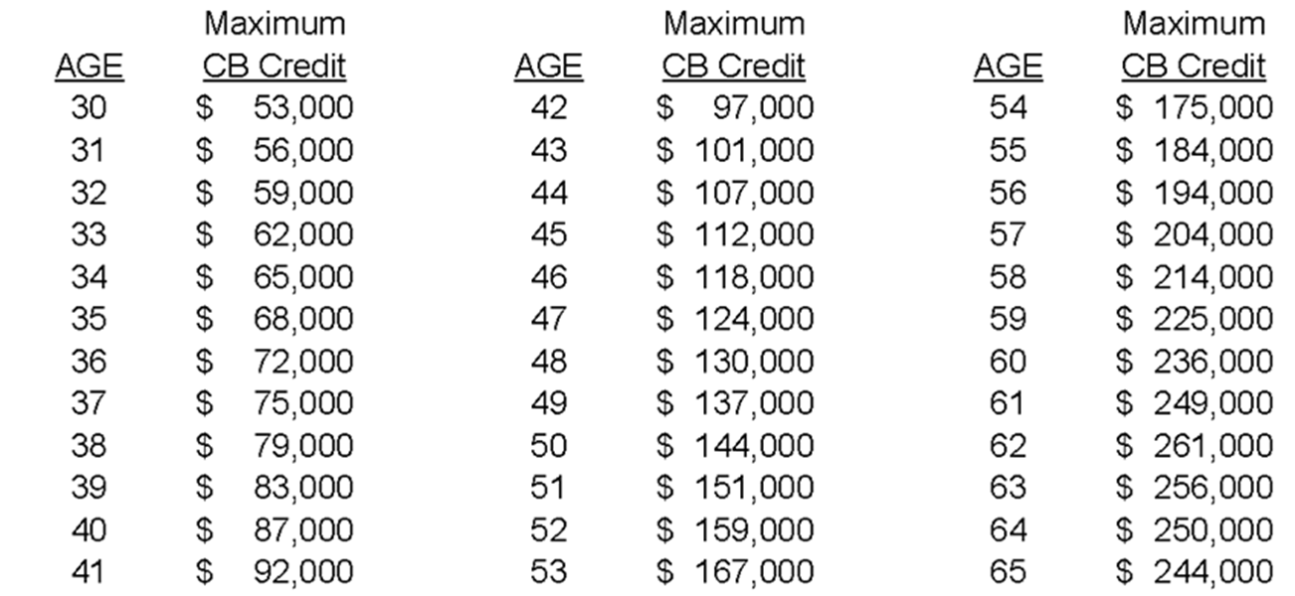
Cash Balance Plan
Individual Contribution Limits - 2014

Slide 14
As Financial Consultants, Why Should You Care?
What’s in it for you?
Assets under management accumulate quickly
  Cash Balance Plan is one pooled account overseen by Plan Trustees…..no employee education of investment options as in 401(k)
  Much more in the way of “assets per time spent” than in 401(k)
For existing clients – if you don’t bring this idea to them then someone else might
For prospective clients – shows diversity of expertise and creates opportunity to take over an existing pool of assets in DC plan

Slide 15
Real Life Example #1:
NC Dentist with Spouse, and 5 Employees
 | CB Plan Contributions | DC Plan Contributions | Total
Dentist age 60 | $195,000 | $38,300 = 6% + max 401(k) | $235,300
Spouse age 44 | 4.0% of pay | 6.0% of pay | 10.0% of pay
Employees | 4.0% of pay | 6.0% of pay | 10.0% of pay
In this plan, the total Cash Balance plan contribution for the initial year was approximately $203,680. Of this total, $196,440 (96%) was credited to the owner and his spouse. While this company had an ideal configuration (and the demographics of each employee group will ultimately determine the outcome), these concepts can make a Cash Balance Plan very compelling to certain plan sponsors.

Slide 16
Real Life Example #2:
Pennsylvania Cardiology Group
 | Employer CB Plan Contributions | DC Plan Contributions | Total
Nine Physician Group | $11,500-$124,500 per doc | $23,500 to $54,500 per doc | $35,000-$179,000 per doc
Total for Physicians | $560,000 | $307,000 | $867,000
Employees | <$10,000 | $110,000 | $120,000
Totals | $570,000 | $417,000 | $987,000

Slide 17
Real Life Example #3:
Upstate NY Orthopedic Group with 23 Physician-Owners and 400 Employees
 | CB Plan Contributions | DC Plan Contributions | Total
Physicians over 60 | $160,000 | $52,000/$57,500 | $212,000/$217,500
Physicians 52 – 59 | $120,000 | $52,000/$57,500 | $172,000/$177,500
Physicians 45 – 51 | $75,000 | $52,000 | $127,000
Physicians under 45 | $50,000 | $52,000 | $102,000
Employees | 2.5% of pay | 5.0% of pay | 7.5% of pay
Total Annual Contributions | $2.6 million | $2.7 million | $5.3 million
Value of Plan Assets | $22.5 million | $30.0 million | $52.5 million

Slide 18
Who are Typical Candidates for Cash Balance Plans?
Sole proprietors age 40 or older, earn more than $250,000 and want to save as much as possible on a pre-tax basis
Profitable, closely-held small businesses
Professional service organizations like physician groups, law firms, dental groups, accounting and engineering firms
Companies with non-qualified retirement plans in place for their key executives
Directors of Companies who receive 1099 income

Slide 19

Pre-Qualifying Questions for Business Owners
Are you maximizing contributions to the 401(k) Plan but would like to save even more on a pre-tax basis?
Are you willing to spend 5.0%-7.5% of pay in such a program for your employees?
Note that the company may already be making contributions above this level.

Slide 20
How BPAS Can Help you Sell, Set-up
& Oversee Cash Balance Plans
Free advice: Review of your potential Cash Balance Plan prospects to determine if they are viable
Free proposals: All we need is a census and a copy of the prospect’s current 401(k) Plan document/adoption agreement
Assistance with investments through BPAS Fiduciary Services
First tier administration and actuarial services
  We are actuaries and administrators to more than 800 defined benefit plans ranging in size from 1 person start-ups to a top 15 grocery chain with 20,000 employees and $350M in CB plan assets

Slide 21

Questions?

Slide 22
Contact
William Nusblat
Vice President
Harbridge Consulting Group, LLC
355 Lexington Avenue
New York, NY 10017
Telephone: (212) 284-9020
wnusblat@bpas.com
www.bpas.com

