Slide 1
A Bird’s Eye View of the Retirement Plan Business
By Paul Neveu, SVP Sales and Marketing, BPAS

Slide 2
Agenda
Additional industry-level perspective
Trends seen in today’s plans
Changes impacting financial intermediaries
Focus on outcomes

Slide 3
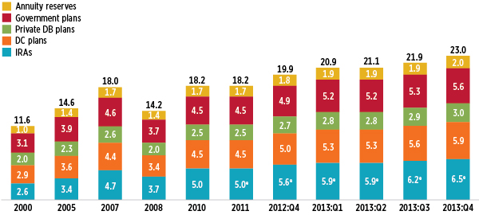
Retirement assets today, $T (per ICI, Q4 2013)
.. A 62% increase in total assets since the end of 2008.

Slide 4
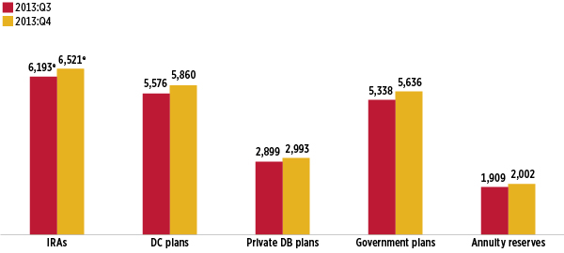
Retirement assets… one quarter change (ICI)

Slide 5
Total DC plan assets.. $5.9T as of Q4, 2013
Traded securities, ETFs, company stock, Collective Investment Funds, closed end funds, etc.

Slide 6
Some key DC industry statistics
Average participation rate = 82.6% for plans with a match, 78.3% for plans with no employer contributions (PSCA)
Use of target date funds continues to grow = 68.6% of plans offer them
Company contributions = average 4.1% of payroll (401kHelpCenter)
Asset allocation = typical plan has 60.6% in equities

Slide 7
Some Key 401(k) Statistics
Automatic enrollment in 45.9% of plans
Investment advice:
Offered in 57.8% of plans (up from 51.8% in 2008)
19.3% of participants use when offered

Slide 8
Average balances across BPAS (12/31/2013)
401(k) Plans: $48,261
403(b) Plans: $30,046 (understated due to multi-vendor factor)
1081.01 Plans: $17,064
457(b) Plans: $63,361
457(f) Plans: $161,442
All DC Plans: $37,217
Fidelity average 401(k) balance: $89,300 (end of 2013), versus $64,200 (end of 2009).. Increase of 39% during this time

Slide 9
Workers who expect to retire later than planned

Slide 10
Percentage of employees who actually calculate how much they will need in retirement

Slide 11
Methods of determining savings needed for retirement

Slide 12
How much do employees think they will need to accumulate by retirement age?

Slide 13
Average mutual fund expense ratios have declined continuously since 1990

Slide 14
Today, we are seeing movement to….
Auto enrollment / automatic escalation plans
Full online enrollment, including online beneficiary designations
Greater convenience, reducing risks for all parties from manual processes
Fiduciary service models (3(21), 3(38))
Level compensation, fee normalization (in lieu of ERISA recapture)
Age-based QDIAs as defaults (55% of BPAS plans now use QDIAs)
Proliferation of CIFs (large plans, QDIAs, eliminate models, and more)
Fee transparency (408b2, no hidden compensation, no finder’s fees, being up front about the true costs of servicing a plan)
DB / DC combo plans due to higher marginal tax rates

Slide 15
Additional trends
“Dashboard meetings” … focus on key success indicators
Going to one of three safe harbors… 22% of BPAS plans now a SH
Proliferation of MEPs and METs
Payroll provider integration (180, 360 degree)
Provider consolidation and acquisitions
still some aspirational pricing models in play
Push for greater participant engagement (education, advice, guidance tools, gamification, personalized sessions.)
Concern over bankruptcies has driven interest in VEBAs (municipalities, unions, etc.)

Slide 16
Some Key 401(k) Statistics
Automatic enrollment in 45.9% of plans
Investment advice:
Offered in 57.8% of plans (up from 51.8% in 2008)
19.3% of participants use when offered

Slide 17
Trends in Plan Design
Moving to safe harbor
New comparability profit sharing allocation
Paired cash balance plan with 401(k) / profit sharing plan
Converting profit sharing to match
Stretching out the match
Automatic enrollment with auto escalation

Slide 18
Trends in Plan Design
Loan continuation / loan automation programs
Age-based defaults (QDIAs)
Earlier entry dates
Allowing part time employees to participate
Adding installment payment option

Slide 19
Practical issues we all need to address
Not enough participants enrolled in their plan
On BPAS’ DC platform, approximately 280,000 eligible employees tracked, of which 195,000 have a balance (69% of eligible employees)
Not enough participants logging on, using the tools (as of today, only about 27% of Ees have provided their email address, 40% have logged on)
Not enough plans using full online enrollment (about 12% of plans right now, estimated 45% of participant count)
Vast majority of participants are not headed for BPAS’ target: 10 times compensation in retirement plans by retirement age

Slide 20
Average fee schedules for RIAs, Trustees
$500,000 plan 64 basis points
$1M plan 54 basis points
$2.5M plan 43 basis points
$5M plan 38 basis points
$10M plan 34 basis points
$20M plan 29 basis points
Factors: Fiduciary status, number of group and individual meetings, nature of workforce, geographic dispersion, total number of participants, accessibility for individual sessions, additional plan sponsor requests, etc.

Slide 21
A great tool from Thornburg (K2 in Toolbox)
Meet with plan sponsor
Review client needs in light of “dashboard”
Discuss your services to be provided, how often, and when
Negotiate your fee schedule
Set this in place for the year to govern activity

Slide 22
Trends among financial intermediaries
Broker / dealers becoming RIAs
Shift to retirement specialists
Movement to institutional share classes
Some delegating fund monitoring role to focus on plan and participant-level services
Rise of firms acting as consultant
Some moving to flat dollar compensation

Slide 23
More common compliance pitfalls today
Late deposits
Plan document out of date
Document said X, we did Y
Compensation definition didn’t match practice in payroll
Failure to file 5500
Failure to fix failed ADP / ACP test
Failure to distribute required notices
Coverage testing / controlled group issues
Excess contributions (402g, catch up, 415)
Signing documents and amendments on time
Safe harbor issues (advance notice, amendments, etc.)
Incorrect loan payments
Missing or incorrect employer contributions
Vesting handled incorrectly
Distributions paid out incorrectly
Ineligible hardship distributions

Slide 24
The Retirement Gap Report Are your participants headed to a secure retirement?
Monthly report in our plan sponsor website, run for all plans
Based around concept of 10 times projected final pay
35 year old earning $40,000 with total balance of $84,000: Current wealth accumulation factor (WAF) of 2.1
62 year old earning $72,000, balance of $850,000: Current wealth accumulation factor (WAF) of 11.8 (grade of A+)

Slide 25
The Retirement Gap Report Are your participants headed to a secure retirement?
What is it projected to be for each employee at retirement age?
Million multiple is also a factor--not just the WAF score
Averages provided for plan as a whole
Monitoring trends / progress over time is a key focus of BNH

Slide 27
Recap of 408(b)(2) and 404a-5
408(b)(2) – Plan Sponsors
Annual disclosure. Reviews fiduciary status, role of providers, total fees being charged and breakdown among providers.
Will allow an employer to say “our total cost is 1.47% of assets, of which A, B and C are the pieces”
Most providers deliver electronically. Must be updated when there is a material change in the fee arrangement
404a-5 – Participants
Annual disclosure and including fees on quarterly statements
Summary of fees being charged to plan, listing of funds, performance, expense ratios, benchmarks and annual cost per $1,000 invested
Provided annually to eligible participants
E-delivery helps, but only with affirmative consent of participant
Updated annually and when there is a change (30 days advance notice)

Slide 28
Putting our focus on outcomes
The ultimate goal of any retirement plan, especially DC plans
We spend an inordinate amount of time on other issues that are far less significant in the end
Helping clients understand these matters is your first mandate… then helping improve key success indicators over time is what you are paid for
Dashboard meetings and the Retirement Gap Report… will help you remind clients about the mission of the plan and encourage a long term relationship with your firm

Slide 29
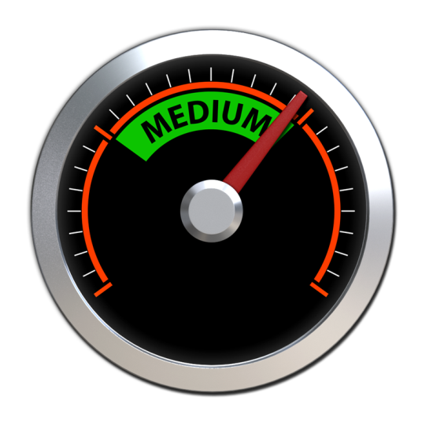
Participation Rate
Average Balance
Contribution Rate
Participation Rate
Avg. Balance
Average Age
Avg. Compensation
Your Plan: 87%
Industry Avg: 82%
Your Plan: $62,470
Industry Avg: $48,261
Your Plan: 41.2
Industry Avg: 45.3
Your Plan: $51,240
Industry Avg: $44,706
Avg Deferral Rate%
ER Contribution %
Current WAF
Project Final WAF
Your Plan: 5,8%
Industry Avg: 5.1%
Your Plans: 5,4%
Industry Avg: 4.1%
Your Plan: 1.8x
Industry Avg 1.1x
Your Plan: 5.2x
Industry Avg: 4.1x

